Slide 1
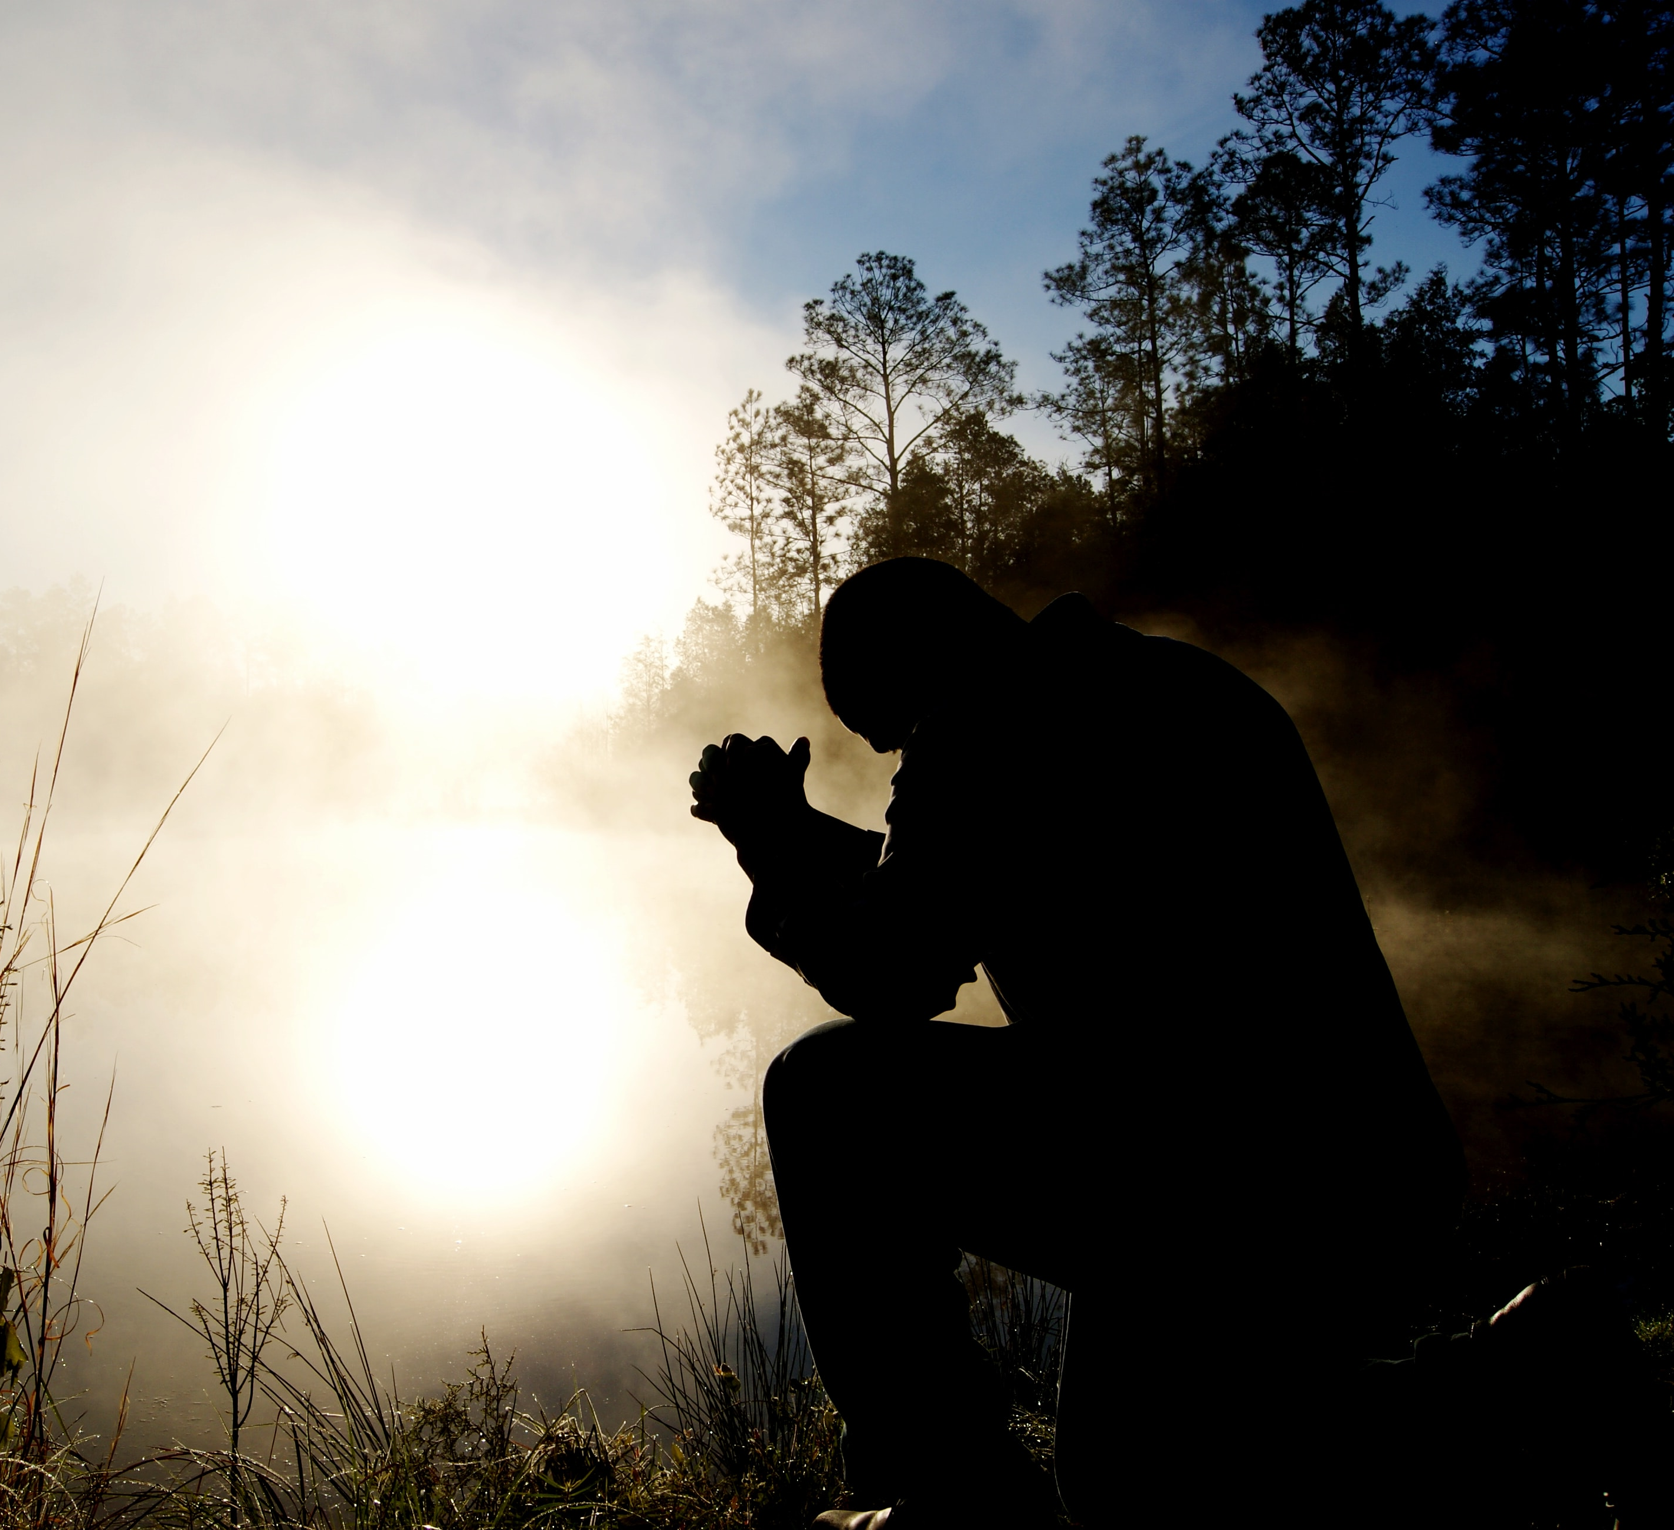
Prayer
Notes:
If someone asked us to explain to them what prayer is, what might we say?
Talking to God, confessing sins asking on behalf of others . . .

Slide 2
Teach me to pray
Notes:
With children when teaching them how to pray we use our hand with the five aspects of prayer—all of which are important. But it is only us talking to God. We often leave out a very important part that makes our relationship with God full and rich; leaves out the idea of LISTENING and FRIENDSHIP and INTIMACY . . .
Jesus calls us friends

Slide 3
Friendship With God
I do not call you servants any longer, because the servant does not know what the master is doing; but I have called you friends, because I have made known to you everything I have heard from my Father.
John 15:15
Abraham believed God, and it was counted to him as righteousness, and he was called a friend of God.
James 2:23
Notes:
How do we grow a friendship?
Time together; talk and listen; share hearts, thoughts, and feelings with one another; Share our hearts with one another

Slide 4
Intimacy & Friendship with God
Notes:
Today we will look at an aspect of prayer that brings us into a deeper communion/intimacy with Jesus. God invites us/longs for us to know him, and to delight in him

Slide 5
Friendship with God
We regard falling from God’s friendship as the only dreadful thing and we consider becoming God’s friend as the only thing worthy of honor and desire (Gregory of Nyssa, 4th century).
Man’s chief end is to glorify God and enjoy Him forever (Westminster Catechism).
For thou has created all things for thy pleasure and for thy pleasure they were created (Revelation 4:1).
Delight yourself in the Lord and He will give you the desires of your heart (Psalm 37:4 ).
Notes:
He delights in us and calls us to delight in him! We are intended to be the delight of God and the object of His affection. He longs for us to know him and to know his great love for us and his delight in us.
Jeremiah 28:13, “All who seek me will find me if they seek me with all their heart.”
Matthew 11:28, “Come to me all who are weary and burdened and I will give you rest.”
God takes pleasure in us and we are to take pleasure in him. As we spend time with God, share our hearts and innermost thoughts; as we quiet ourselves and allow him to share his heart and thoughts with us, we grow intimate friendship with him.

Slide 6
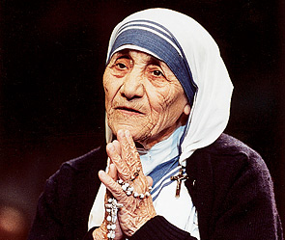
Prayer
Notes:
A wonderful picture of intimate friendship with God: Mother Theresa
Dan Rather’s interview with Mother Theresa on prayer:
So when you pray what do you say?
Nothing, I just listen.
Well….what does God say?
- Usually nothing, he just listens.
That sweet sense of just being together
When I asked the Lord what he wanted me to share with you, I had a picture of a person with his head laid on Jesus’ chest. So I looked for a picture that would depict this idea of resting and intimacy. –go to next slide

Slide 7
But I have stilled and quieted my soul; like a weaned child with its mother, like a weaned child is my soul within me.
Psalm 131:2
Be still and know that I am God.
Psalm 46:10
Notes:
Look at the baby’s face – such peace, security, contentment. I believe God wants this for all of us. He says, “Be still and know that I am God.” I read somewhere (on David Harper’s blog) that we can translate this to “Let go and know that I am God.” So it is a sense of letting go of our thoughts, worries, our busyness and just sinking into and resting into God’s love for us. A sense of scrunching up our hands and then letting go and sinking into that deep rest just like the baby in this picture. So we need to learn to quiet ourselves—to be still—but this can be really hard to do.

Slide 8
Intimate Friendship with God
Intimacy with God seems to be a lost art. Our world has replaced hunger for God with service because serving is easier to do and we can see the results (Henry Nowen).
In this noise and busyness, what is often lost is vital to our spiritual health and maturity–the still small voice of God (Leanne Payne).
“I will remain in the world no longer, but they are still in the world and I am coming to you. Holy Father, protect them by the power of your name – the name you gave me – so that they may be one as we are one (John 17:11).
Notes:
We live in a world of such noise and fear; of electronics everywhere. NoVa is especially noisy and hurried. But Jesus’ life was one of uninterrupted attentiveness to the Father. He walked in total fearless, listening, and obedience to his loving Father. Jesus said, “I only do what I see the Father doing.” The goal of Jesus’ ministry is nothing less than to bring us into that most intimate and loving community. John 17:11 How can we be still enough to enter into that loving community? Lots of tools and ways: read the medieval saints; desert fathers; lectio divina; Jesus prayer; taking a class like Forming. One of the best ways I have found is Immanuel Prayer.

Slide 9
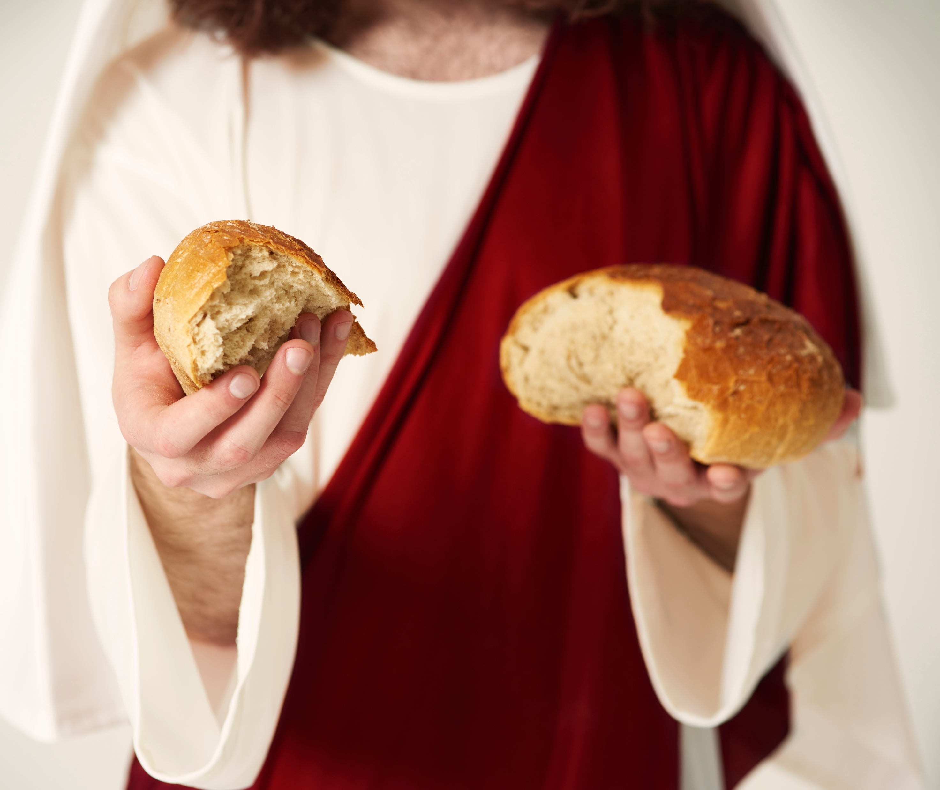
Immanuel Prayer
Notes:
Method for connecting with God by slowing down our body, emotions, and thoughts in order to “be still and know God.” This method is based on the awareness that Jesus is always with us (regardless of how we feel). Immanuel means that God is always with us and desires to interact with us in all situations. He says, “I will never leave you nor forsake you,” Hebrews 13:5. This is a way to help us connect to God in joy—to know that God is always glad to be with us even when we are distressed. A way of listening prayer—who we will be listening for that still small voice of God—we might sense his presence; receive a thought, a scripture, see a picture . . . God gave us our five senses not just to perceive the world we live in but to perceive him as well.

Slide 10
Immanuel prayer
Steps
Prayer of protection
Invite the Holy Spirit
Quiet and relax
Positive Memory/Appreciation
Enjoy/rest in the memory
Connect to Jesus, Father, Holy Spirit
Listen
Notes:
Prayer of protection because we want to hear Jesus voice not our own, the world’s or the enemy’s voice.
Invite the Holy Spirit to come
Quiet and relax: Being able to quiet and relax yourself is one of the strongest indicators of good mental health and we can grow in this ability by practicing it.
Positive memory/appreciation: When we allow ourselves to remember and feel appreciation (think back on a happy/joyful/peaceful experience), oxytocin is released which makes us feel good and prepares our brain for bonding and positive relationship connection (turns on the relational circuits in our brain). When this part of our brain is engaged, we are in a much better position to relate to God and to others. Key is appreciation. Give thanks in all things . . . over and over again in scripture
Spend time enjoying and resting in this memory/positive connection. As we are appreciating, we are actually connecting to God, to the one who created and gave us these good things. Faith, granddaughter…..
Then listen as I ask the Lord questions on our behalf. Look for a thought, feeling, a word, scripture . . .
Lord, what do you love about me?
When you formed me in the womb, what were you excited about?
When you think of me what makes you smile or proud?
Lord, is there anything on your heart you want to share with me?
Anything you want me to know?
As we end our listening time I am going to read some scriptures over you . . .
After Immanuel Prayer exercise and if time allows read scripture over the people.
Ending Prayer: God longs for each of us to know him, to love him, to enjoy him, to delight in him because he knows us, loves us, enjoys us and delights in us. And we each have the awesome privilege of walking with, resting in, and being a friend of God. I pray God’s blessing on us as we pursue this call to “be still and know God.” Amen.

